Slide 1
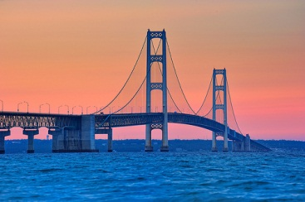
AASHTOWare Bridge Update
Todd Thompson, PE – SD DOT
AASHTOWare Bridge Task Force, Chair
Presented to the RADBUG
Traverse City, MI August 12, 2014

Slide 2
AASHTOWare Bridge Task Force
Chairperson | Todd Thompson (new) | South Dakota
BrM TF – Vice Chair | Eric Christie (new) | Alabama
BrM TF | Mark Faulhaber | Kentucky
BrM TF | Bruce Novakovich | Oregon
BrM TF | Thomas Martin (New) | Minnesota
BrM TF | Beckie Curtis (New) | Michigan
BrM Liaison | Derek Constable | FHWA
BrDR TF | Dean Teal | Kansas
BrDR TF | Jeff Olsen | Montana
BrDR TF | Amjad Waheed | Ohio
BrDR TF | Josh Dietsche (New) | Wisconsin
BrDR Liaison | Tom Saad | FHWA

Slide 3
Bridge Design and Rating Update
AASHTOWare Bridge
Design and Rating
Version 6.6.0
Released
July 2014!
Notes:
Task Force made a decision that we took some items out of 6.6 so we could get the release done as close to June 30th or before as possible. Wanted to get back onto a release cycle of releasing BEFORE July 1st.
Plan is for 6.7.0 to be done on or before July 1st next year.

Slide 4
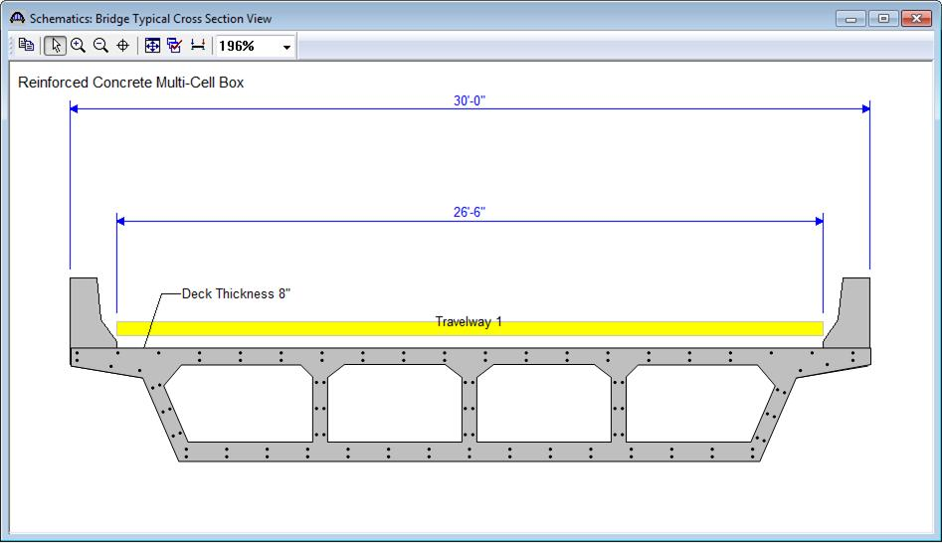
Enhancements for 6.6
Reinforced Concrete Multi-cell Box Beam
LRFD Spec Checking
LRFR
User-defined box cross sections
Line girder analysis, full box or web-lines
Integral with pier

Slide 5
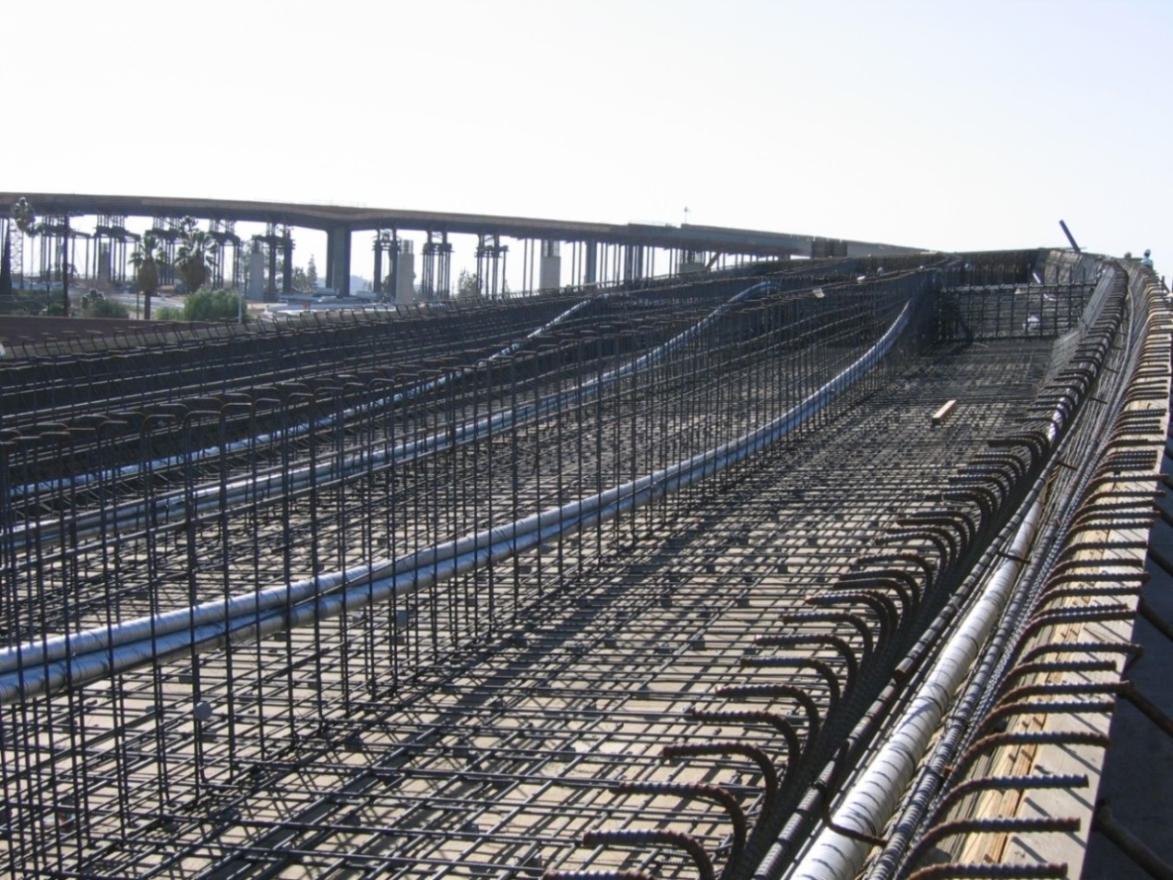
Enhancements for 6.6
Post-tensioned Concrete Multi-cell Box LRFR Rating
LRFR
User-defined box cross sections
Line girder analysis, full box along with web-lines
Integral with pier

Slide 6
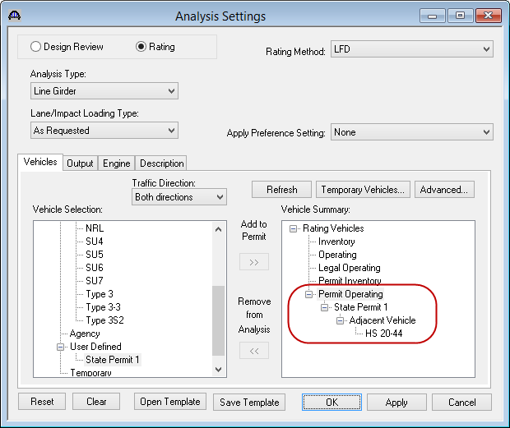
Enhancements for 6.6
Permit Analysis with Adjacent Lane Traffic
Design review and rating analyses
User-defined adjacent vehicle LL factor
Live load distribution factor approach in LRFD Article 4.6.2.2.5

Slide 7
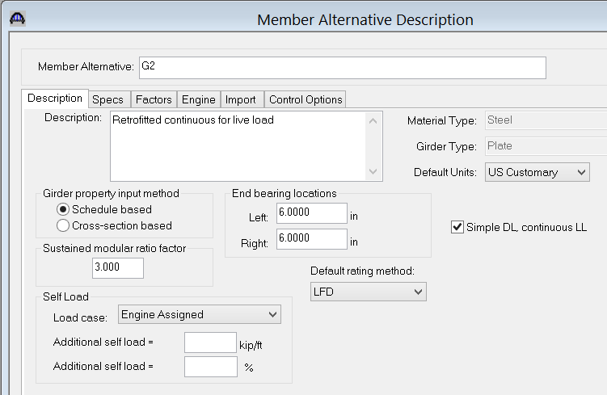
Enhancements for 6.6
Steel Girder Superstructure Continuous for Live Load Rating

Slide 8
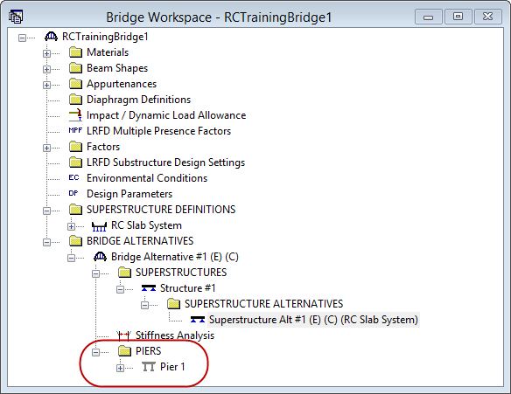
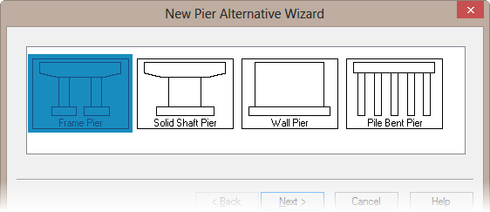
Enhancements for 6.6
Reinforced Concrete Slab System Integral with Pier
RC slab system definition is assigned to the superstructure and the pier will recognize the slab structure type is a RC slab system integral with the pier

Slide 9
Enhancements for 6.6
Curved Girder Enhancements
Live load analysis of bottom flange lateral bracings
Reuse dead load analysis results and influence surfaces
Additional finite element nodes for modeling diaphragm
Display bearing of curve at supports in Superstructure Alternative window
3D Model Viewer enhancements

Slide 10
Enhancements for 6.6
User Group Top Enhancements from Aug. 2013 Meeting

Slide 11
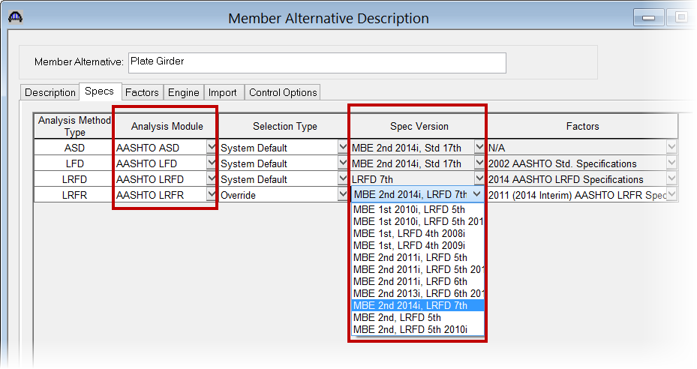
Enhancements for 6.6
Specification Updates
AASHTO LRFD Specification updates (7th Edition)
AASHTO Manual for Bridge Evaluation Specification updates (2nd Edition with 2014 Interim)

Slide 12
Modernization Update
System is nearly 15 years old – first released April 1999
Software tools for development have significantly changed and improved
User expectations have matured
Hardware has improved, need to take full advantage of new hardware capabilities (e.g. multi-threading, 64 bit, etc.)

Slide 13
Modernization Update
When development started
Windows 95 or NT were common and were replacing Windows 3.11
Needed a 386DX processor
Needed minimum 4 MB RAM (8 MB recommended)
Hard drives in the 40-100 MB size common
There have been 7 versions of Windows O/S since we started
Windows 98, 2000, ME, XP, Vista, 7, and 8

Slide 14
Modernization Update
Currently
Windows 7 or 8 – 64 Bit
Memory – 16 to 32 GB common
Hard drives in 1 or 2 TB common, very fast solid state drives becoming common in 250-500 GB range
Tremendous changes in OS and Hardware over the last 15-19 years

Slide 15
Modernization Update
Migration to a new architecture using the latest development tools
Improve analysis performance by taking advantage of the latest hardware and software advances – multi-threading
Improve the user interface - easier to use for beginners without losing modeling flexibility for advanced users
Improve reporting capabilities
Reduce maintenance costs
Reduce implementation time for new features

Slide 16
Modernization Update
Architecture Design is Underway
Conducted a workshop to identify the requirements that drive the architecture design
Currently working on the high-level architecture design
Evaluating the user-interface requirements
Work has started on the modernization of the finite element engine
Solicitation for funding early next year (2015)

Slide 17
Plan for 6.7.0
What is under development for 6.7.0?
User Group Enhancements
Gusset Plate Rating
Splice Analysis
Cut top strand for PS Concrete Beams
Splayed Girder – Distribution Factor
RC Slab System – Substructure
Culvert – Shear General procedure
Exposure Factor - Culvert

Slide 18
Plan for 6.7.0 continued
LRFR for Floor Systems
Analysis Template vehicle export
AISC Steel shapes update
Steel Plate Girder Design Tool
Straight Girder (3D) Modeling Improvements
Specifications Update (from 2014 SCOBS meeting)
Plus Continued
User Support and Maintenance (bug fixes)

Slide 19
Other activities
Design Tool
Efforts underway for a PS Design Tool
Jeff Olson to discuss further later today

Slide 20
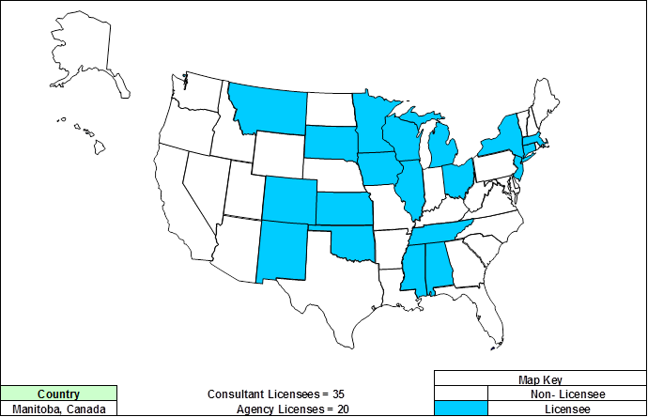
Bridge Design Licenses (FY 2014)

Slide 21
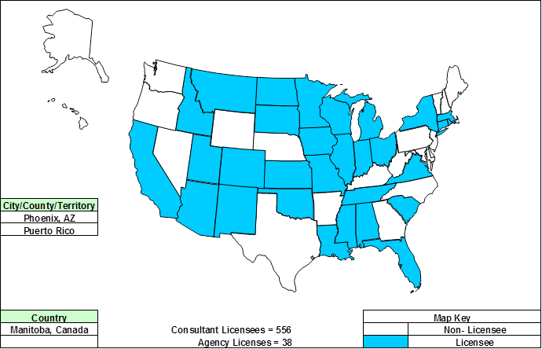
Bridge Rating Licenses (FY 2014)

Slide 22
AASHTOWare Bridge Task Force
Chairperson | Todd Thompson (new) | South Dakota
BrM TF – Vice Chair | Eric Christie (new) | Alabama
BrM TF | Mark Faulhaber | Kentucky
BrM TF | Bruce Novakovich | Oregon
BrM TF | Thomas Martin (New) | Minnesota
BrM TF | Beckie Curtis (New) | Michigan
BrM Liaison | Derek Constable | FHWA
BrDR TF | Dean Teal | Kansas
BrDR TF | Jeff Olsen | Montana
BrDR TF | Amjad Waheed | Ohio
BrDR TF | Josh Dietsche (New) | Wisconsin
BrDR Liaison | Tom Saad | FHWA

Slide 23
Questions & Comments
Thank you for your continued support!

