Slide 1
Designers using Bridge Rating BrR for Accelerated Deck Replacements
By Brenda Crudele
Bridge Design & Rating User Group Meeting
Virginia Beach, Virginia
August 2013
NEW YORK STATE DEPARTMENT OF TRANSPORTATION
Main Office Structures

Slide 2
Agenda
-What is New York Works - Accelerated
Bridge Program?
-Goals of Accelerated Bridge Program
-How did we accomplish the work in
such a short time?

Slide 3
NY Works Program
Accelerated Bridge Program (ABP)
Phase 1A Design/Bid/Build
Phase 1B Design/Build
Accelerated Pavement Program
Signature Projects Program
Total Cost $1.167B

Slide 4
Goals of ABP
Raise Bridge Condition Ratings to 5.4 or better
Remain Non-Deficient for at least 10 years.
Deck Service Life should be that of the remaining life of bridge
Eliminate joints where possible
Improve Load Rating (Provide a min. LR of HS-20, 36 Tons Inventory)
Bridges go from “Fair” → “Good”
Stay within Budget
Notes:
Bridge work

Slide 5
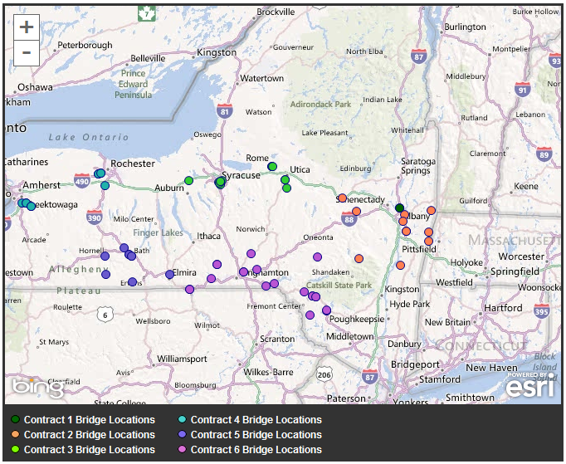
Geographic Location of Bridges in Original 6 Contracts
Notes:
Originally 6 contracts with 64 bridges. 3 additional contracts were added with another 17 bridges.

Slide 6
Time Frame for ABP
Design
Design Started January 3, 2012
First Contract PS&E Feb 23, 2012
Last Contract PS&E Mar 28, 2012
12 Weeks Total, 5 Bridges/week
Construction
~Half Bridges Constructed in 2012
~Half Bridges Constructed in 2013

Slide 7
How Did We Design 61 Deck Replacements in 2.5 Months?
Used a proposal only format. No plans.
Designers used existing BrR files to progress design of deck replacement.
Utilized most of the MO Structures design staff (13 Designers and 3 QA reviewers)

Slide 8
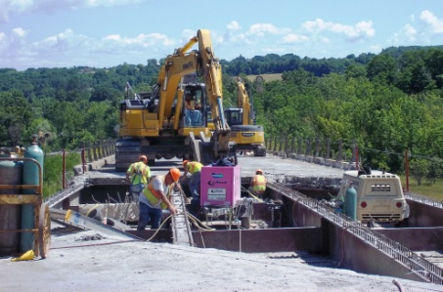
Proposal Only Deck
Replacement Contracts
In a hurry?
Who needs plans!
Rt. 8 over S&W RR – Region 2, Contract 3
Notes:
In 2008 in anticipation of the American Recovery and Reinvestment Act (ARRA or stimulus act) the Office of Structures put forth a concept that deck replacement project could be done by proposal only and without plans. This was a short six page document listing the purpose, candidate selection criteria, and guidance for preparation of project proposals. This idea of proposal only deck replacement did not come to fruition for ARRA. However in late 2011 when talk of NY Works and Accelerated Bridge Program, the ideas was dusted off and looked at.

Slide 9
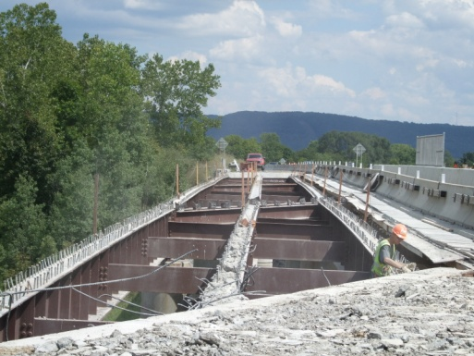
What is a “Proposal Only” Deck Replacement?
I86 over B&H RR – Region 6, Contract 5
Notes:
Discuss what is included in proposal – show proposal
Proposals were put together is a list format. Some existing and proposed Geometry is given along with proposed reinforcement size and spacings for decks and approach slabs. Pay limits were described using notes. Regular notes were given. Some generic details were given along with BD references. BD’s referenced by hyperlink to BD’s on the internet. To save time the quantity table was created from the transport file.

Slide 11
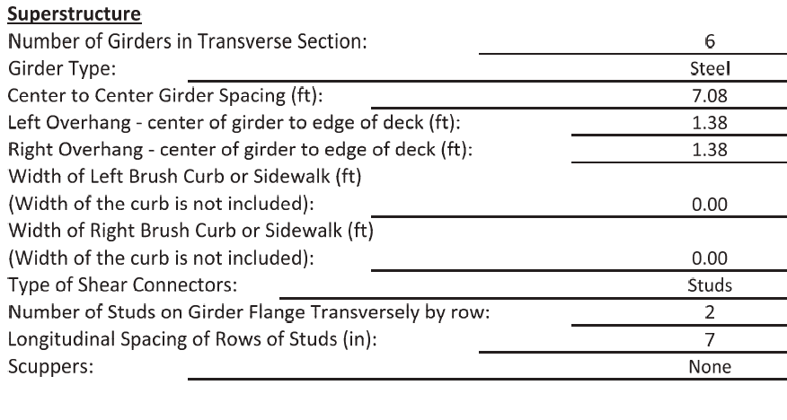

Slide 12
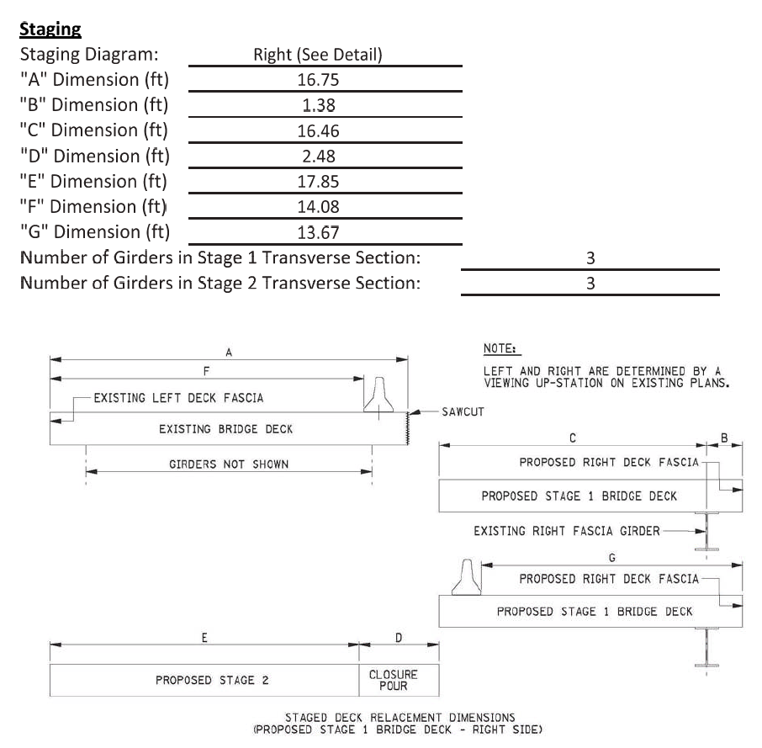

Slide 13
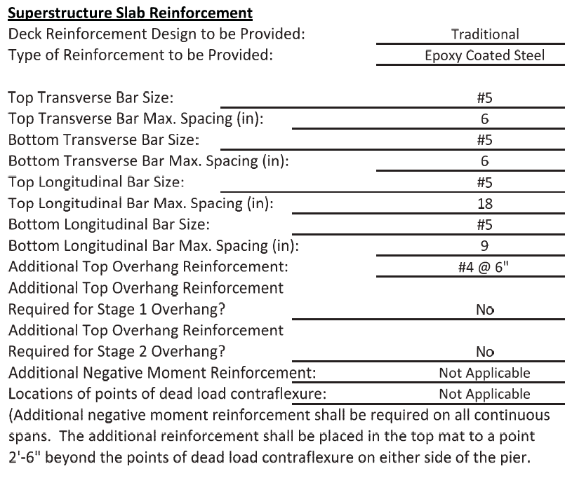

Slide 14
NYSDOT is a Bridge Rating BrR
and
Bridge Design BrD State
Designers using Virtis!!?
Something is not right here.
Notes:
NYSDOT is a virtis and opis state. All of our designers are very familiar with using opis and virtis. This enabled us to hit the ground running with the ABP. Once we had a list of bridges, all of the virtis files were obtained from our load rating engineer. Designers modified the existing files based on the replacement deck.

Slide 15
BrR Software was utilized for 59 out of the 61 deck replacements
ABP Accomplishments
Precast Decks utilizing Accelerated Bridge Construction (ABC)
5 Bridges will be completed in 1 weekend
6 Bridges will be completed in < 2 weeks
Notes:
11 precast decks
2 twin bridges.

Slide 16
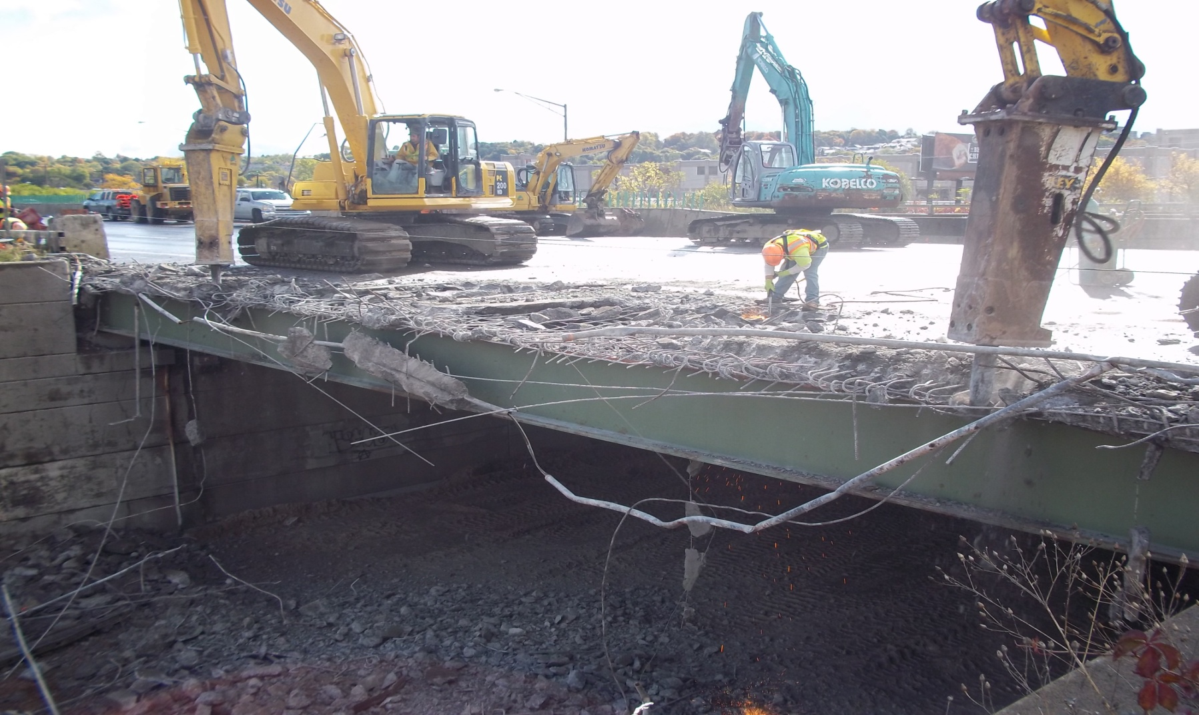

Slide 17
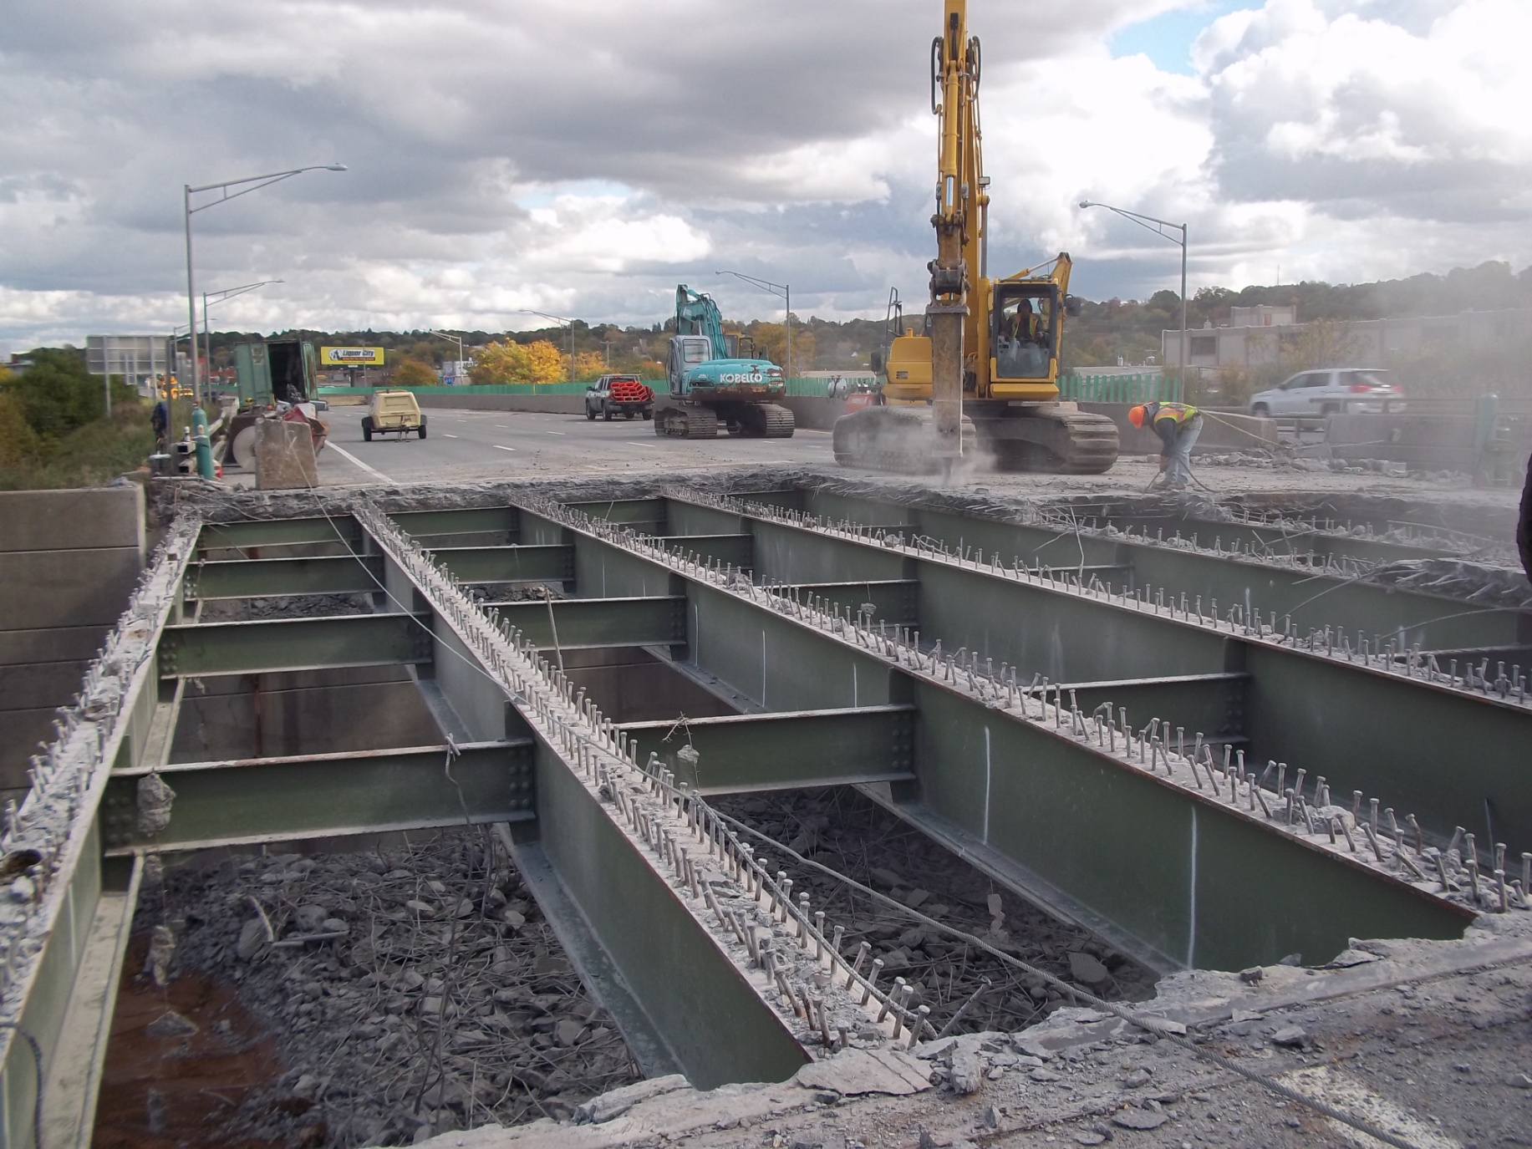

Slide 18
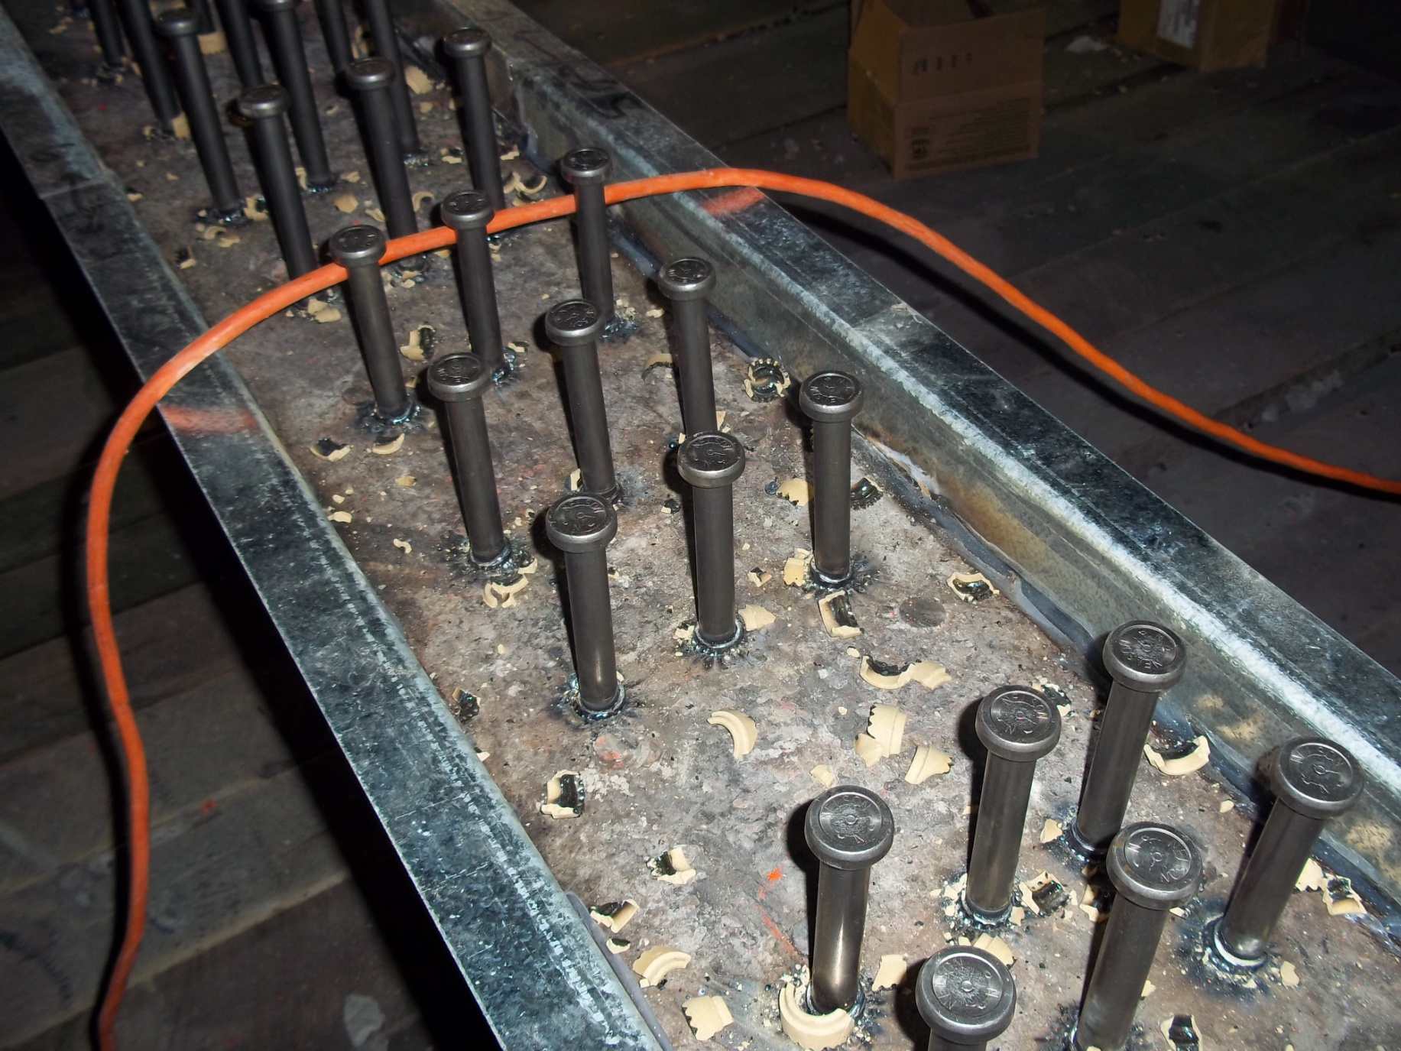

Slide 19
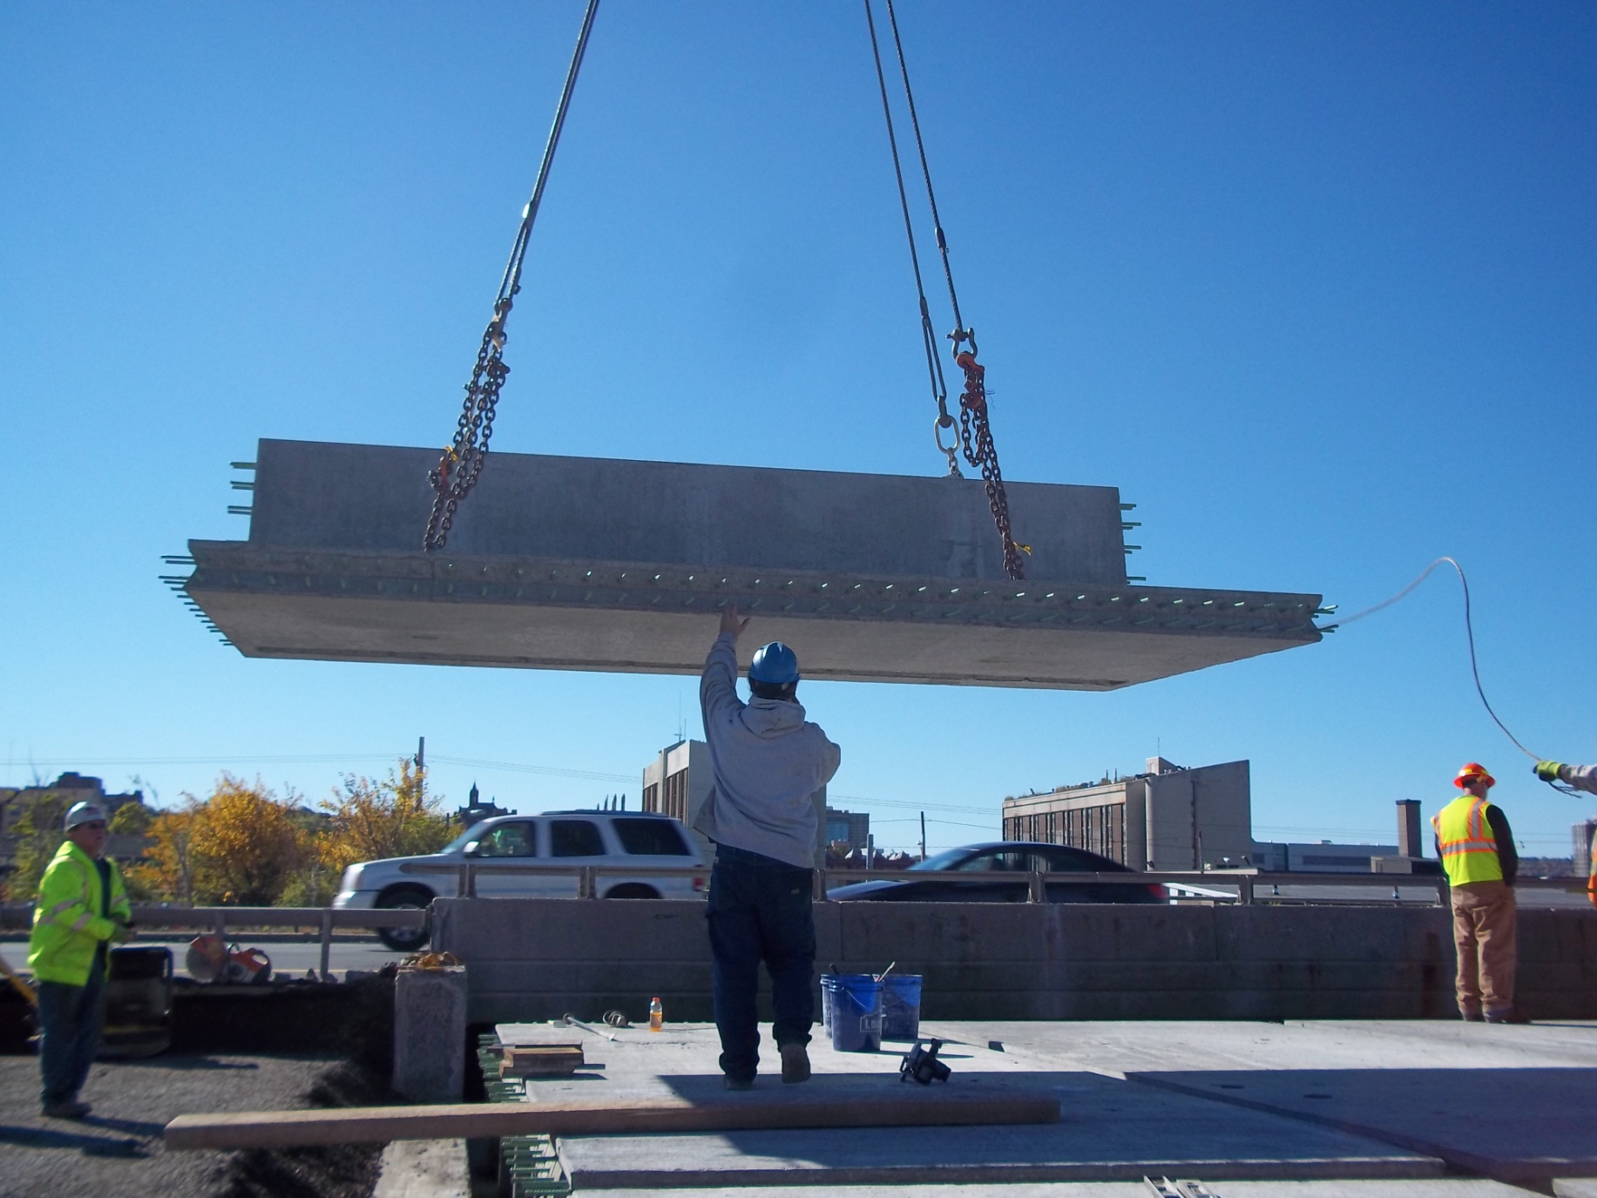

Slide 20
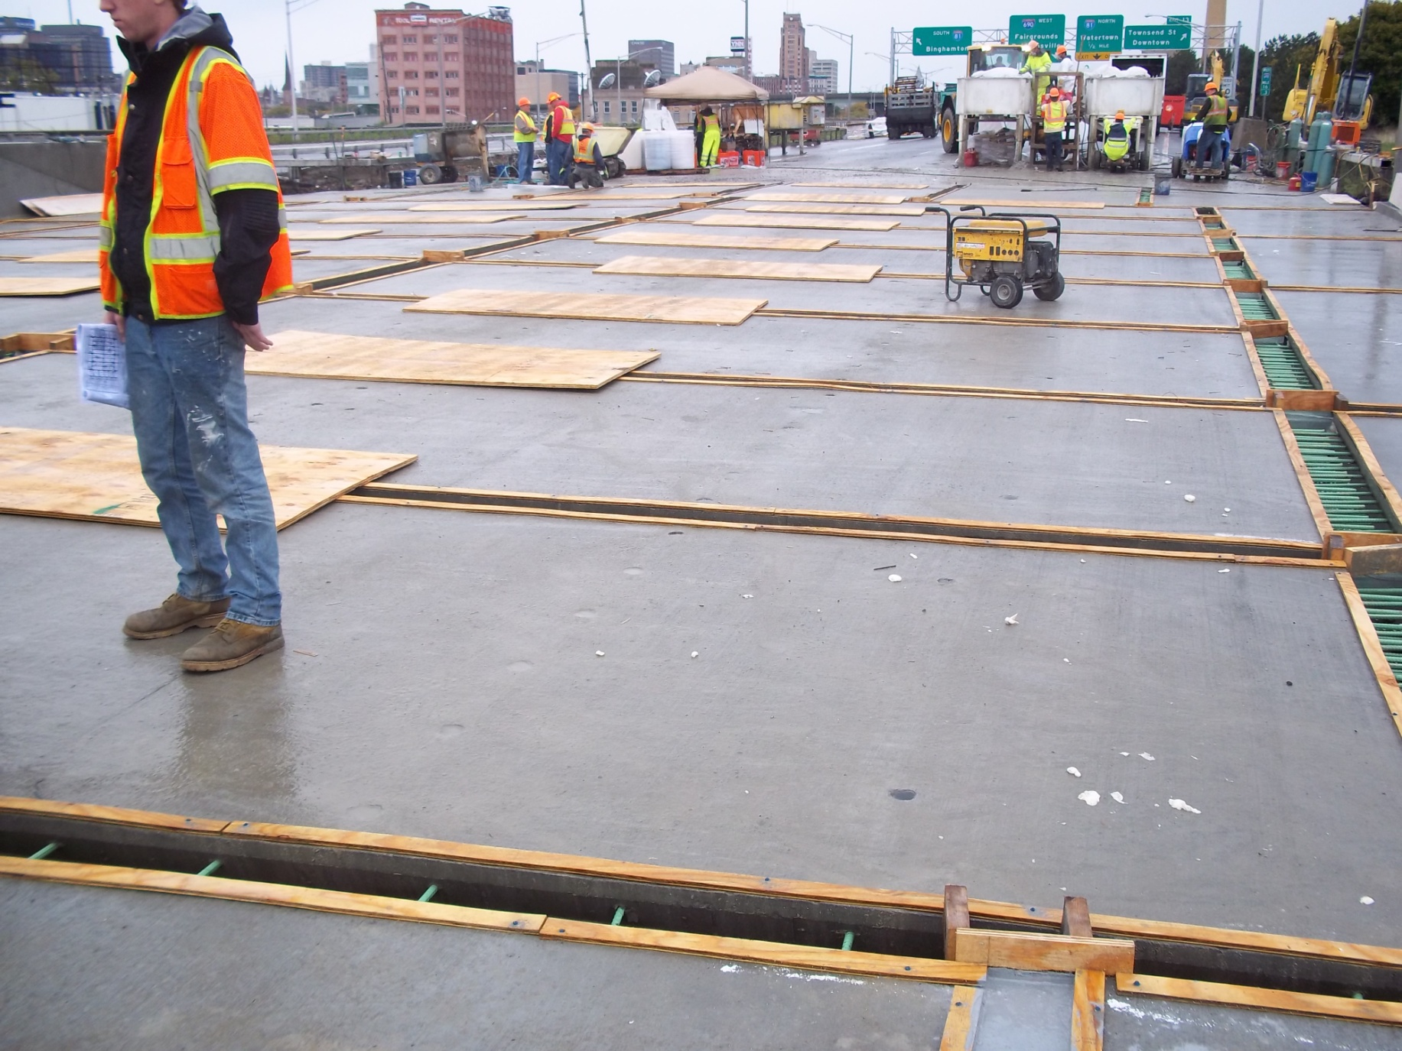

Slide 21
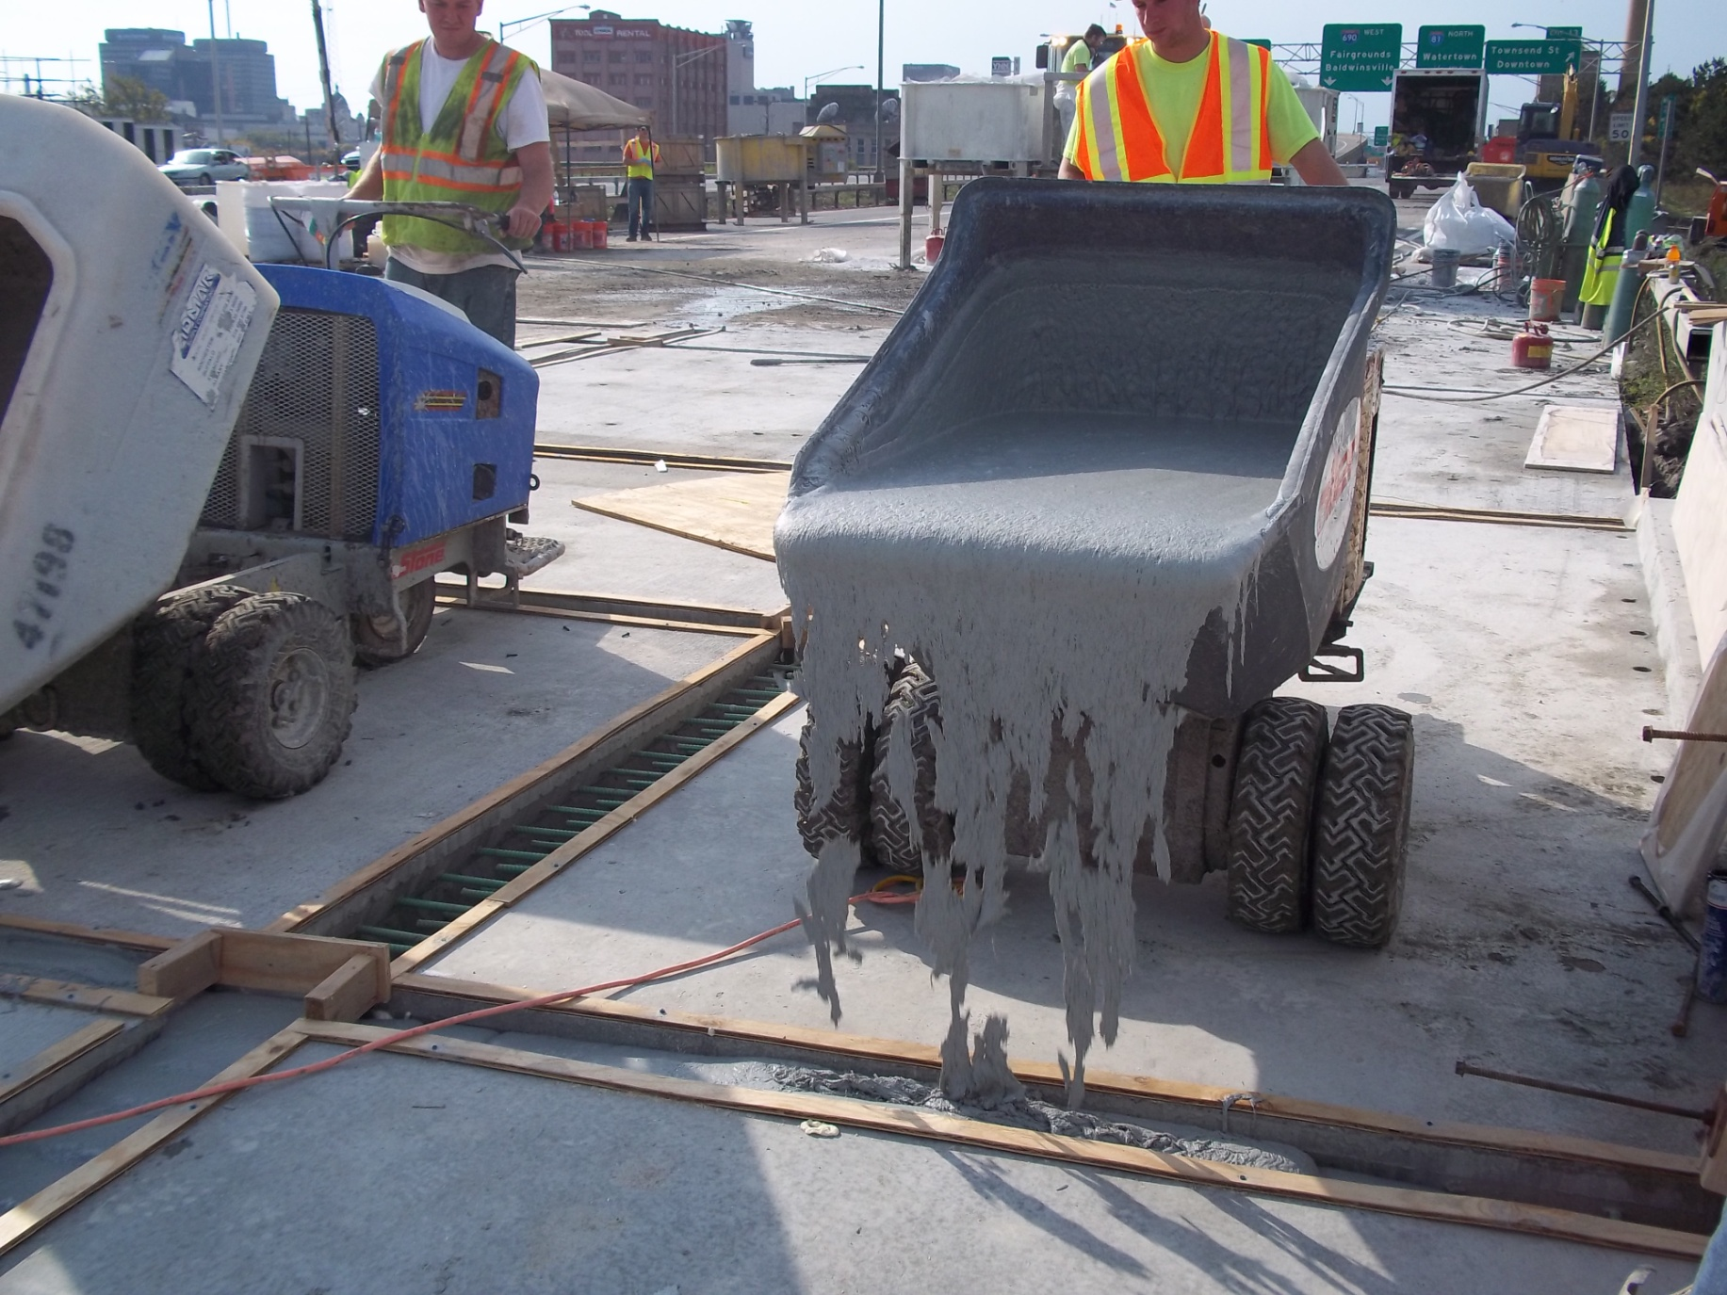

Slide 22
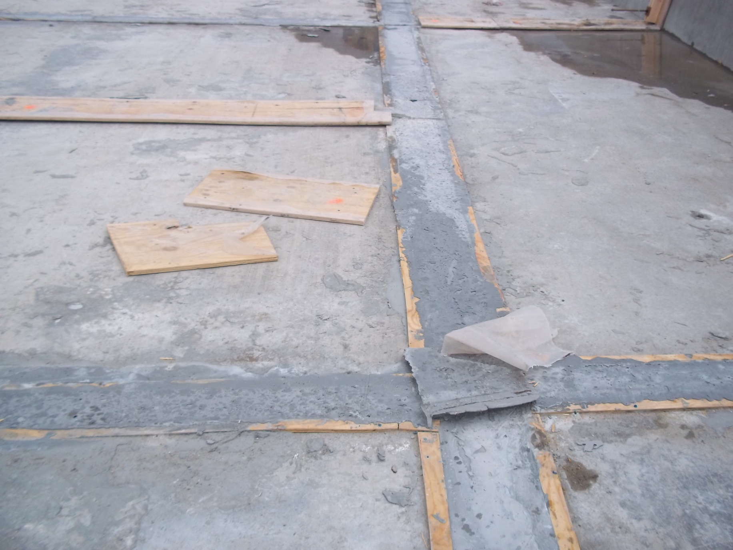

Slide 23
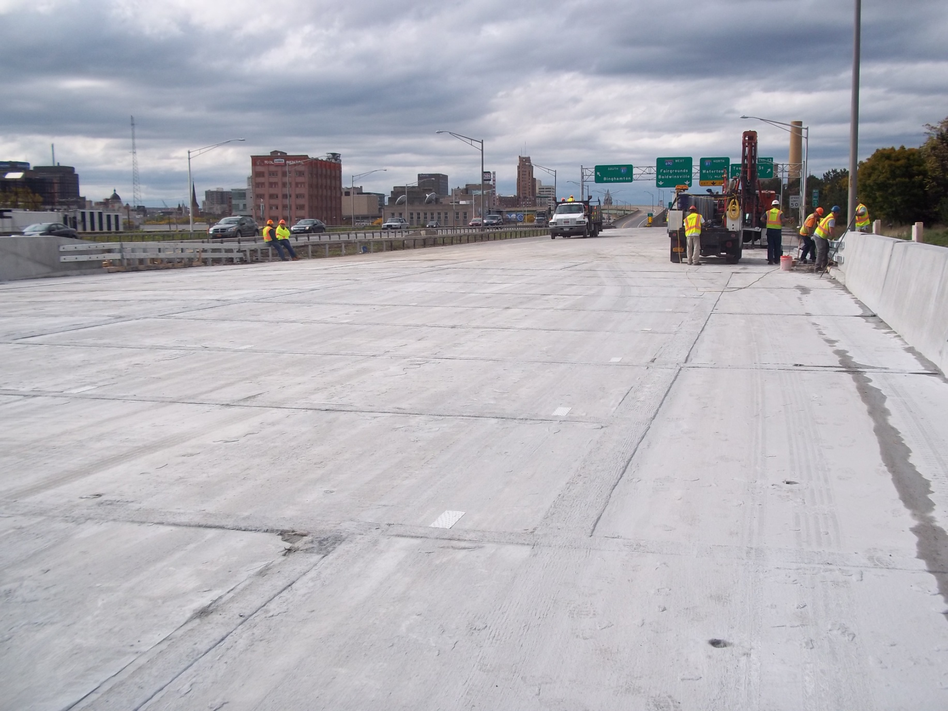

Slide 24
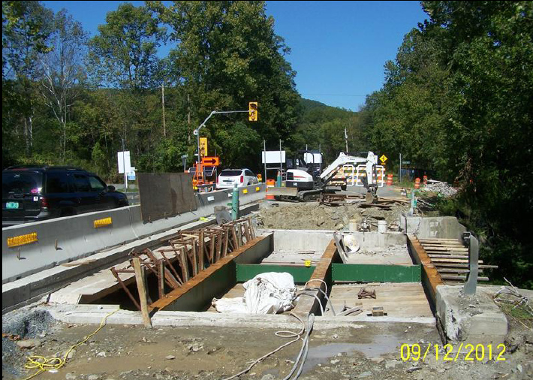
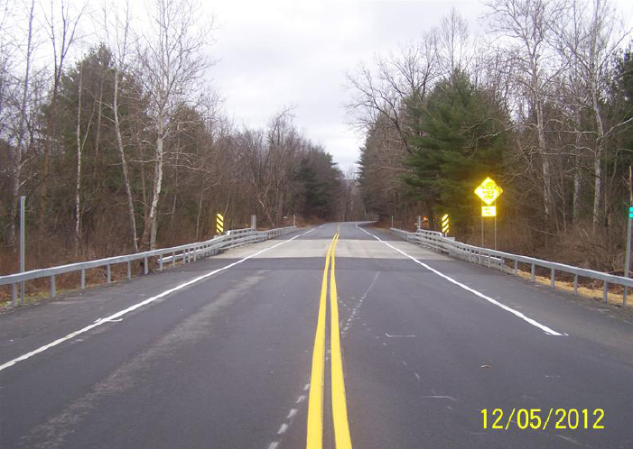
Improved Load Ratings - 45 Bridges
Added Shear Studs
Load rating went from
HS9.7 to HS 20.6
Route 22 over Dill Brook,
Petersburg, NY
Bridge Length = 38 feet
Deck Area = 170 square yards
Notes:
Load ratings were increased on 45 out of 61 bridges.
9 non composite bridges were made composite. Load ratings doubled.

Slide 25
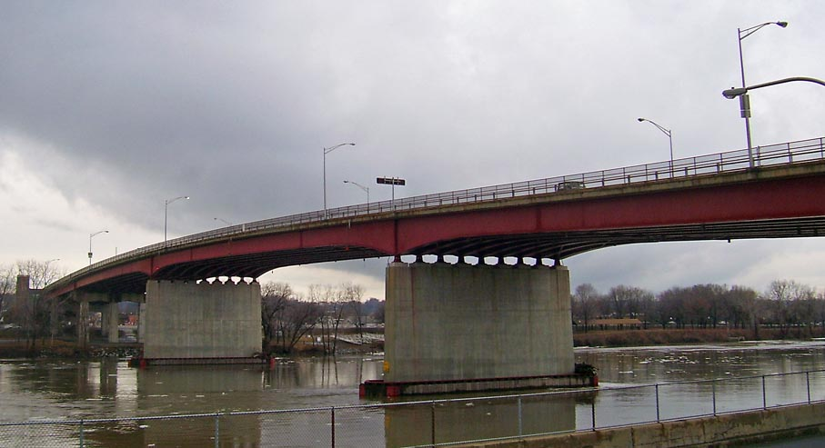
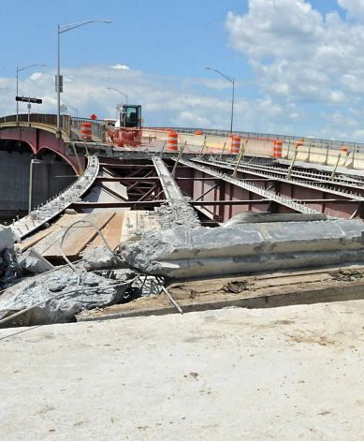
ABP Accomplishments
Congress Street Bridge in Troy, NY
Bridge Length = 1410 feet
Deck Area = 12,716 square yards
Crosses I-787, Hudson River, and Front Street
Region 1, Contract 2

Slide 26
ABP Accomplishments
104 Jointless Abutments
21 Bridges Utilizing Stainless Steel Deck Reinforcement
20 Bridges where Scuppers are completely Removed
¾ Million SF of Deck Area
3 Bridges with Light Weight Deck and Barriers
Notes:
What was mistake on willowemac bridge?

Slide 27
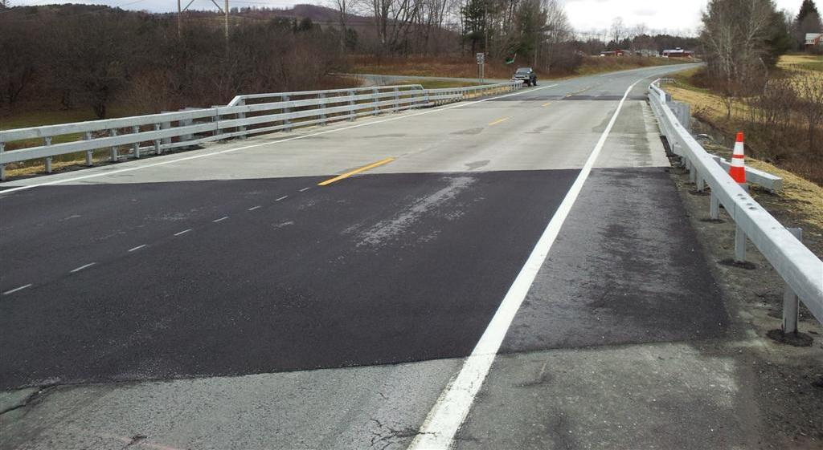
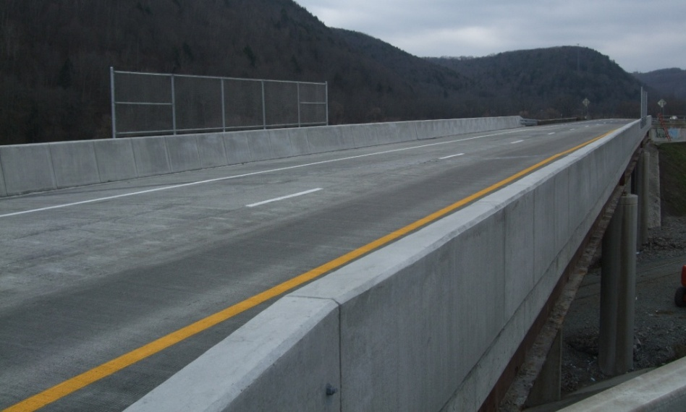
Summary
Used a proposal only format.
Designers utilized existing BrR files
Utilized most efficient design staff

Slide 28
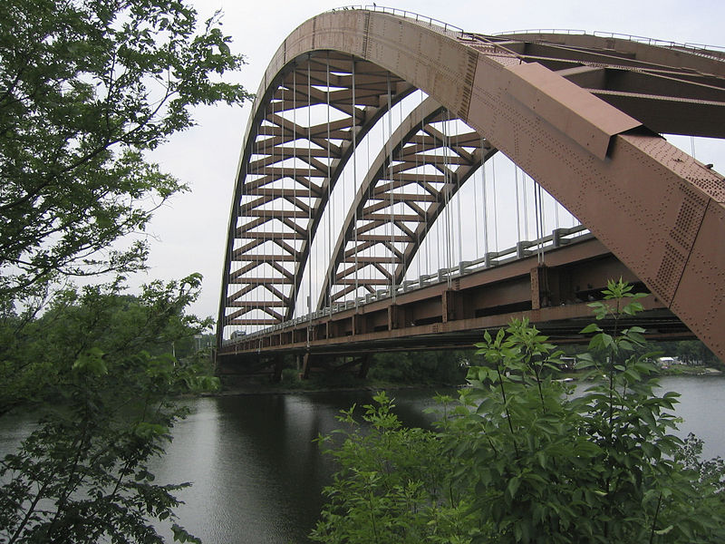
BrR Software could not be utilized for Steel Arch Bridge – I87 over Mohawk River

Slide 29
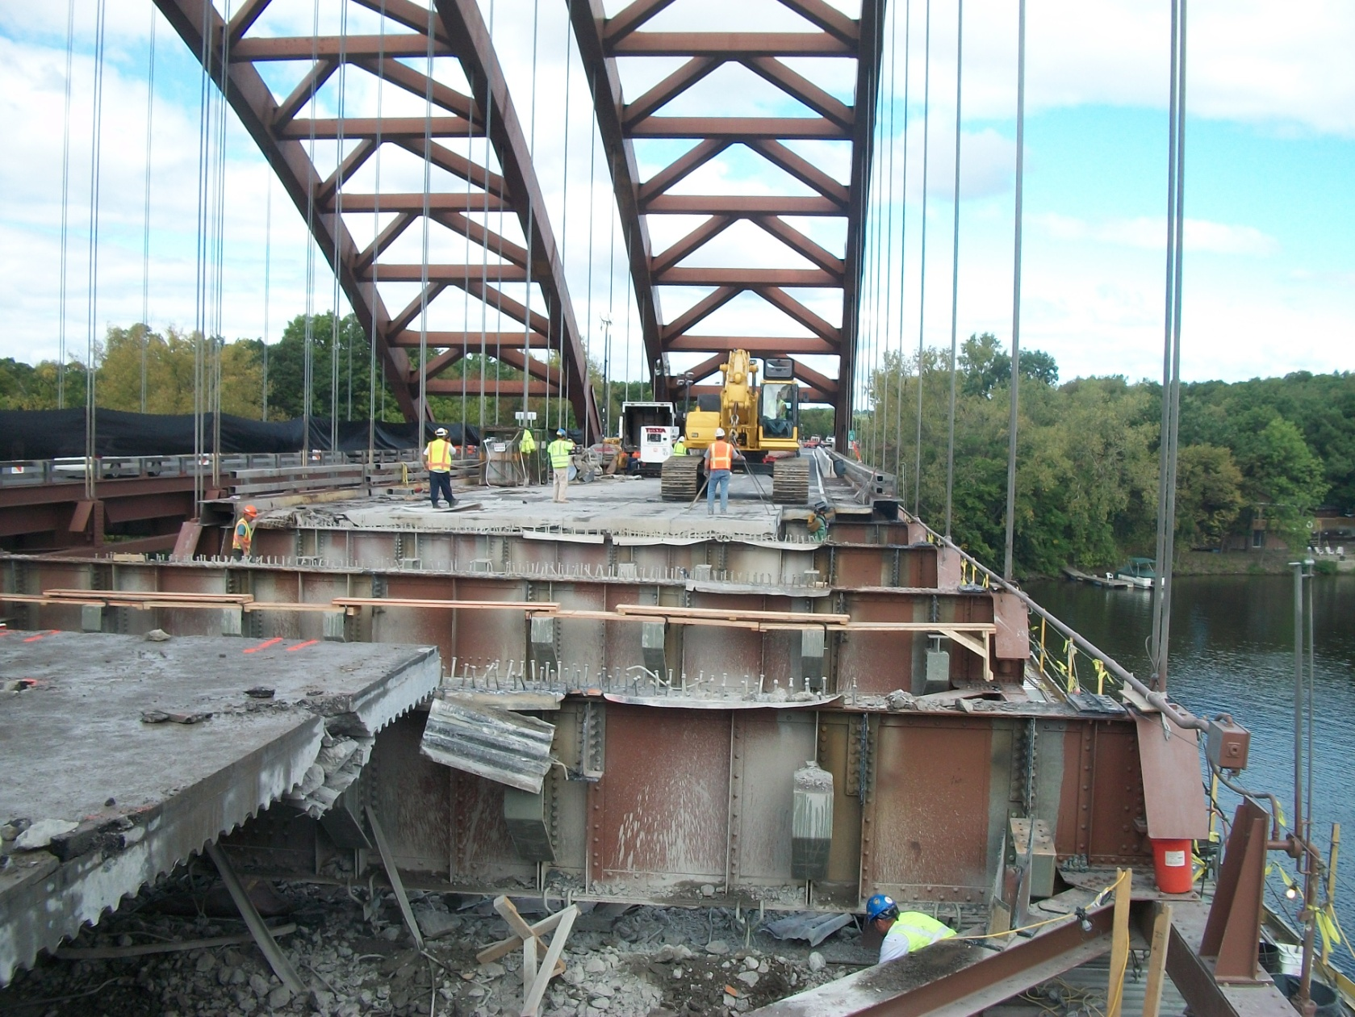

Slide 30
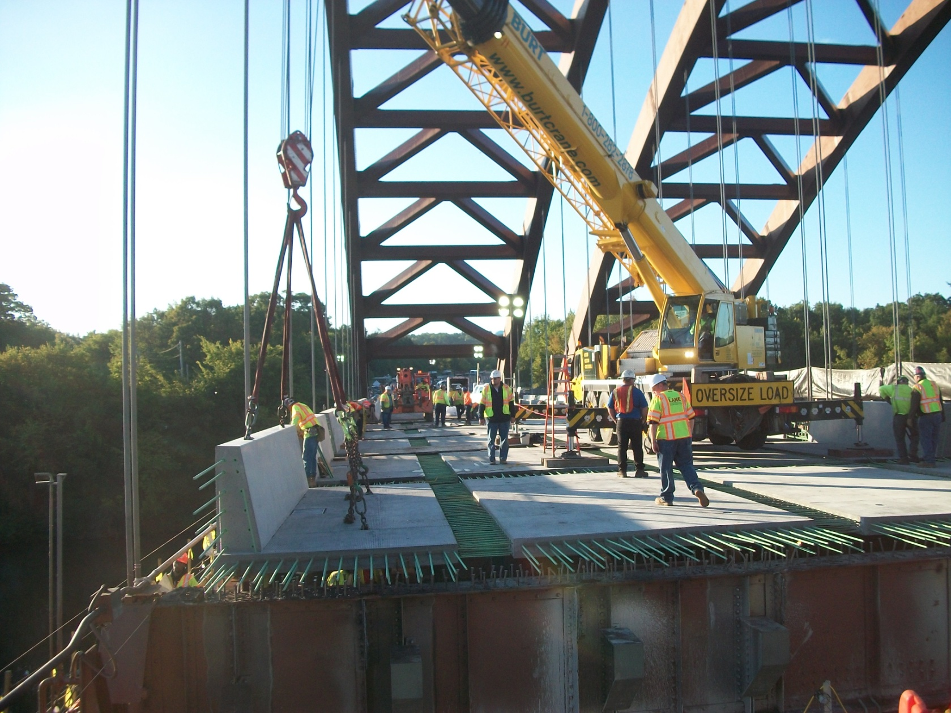

Slide 31
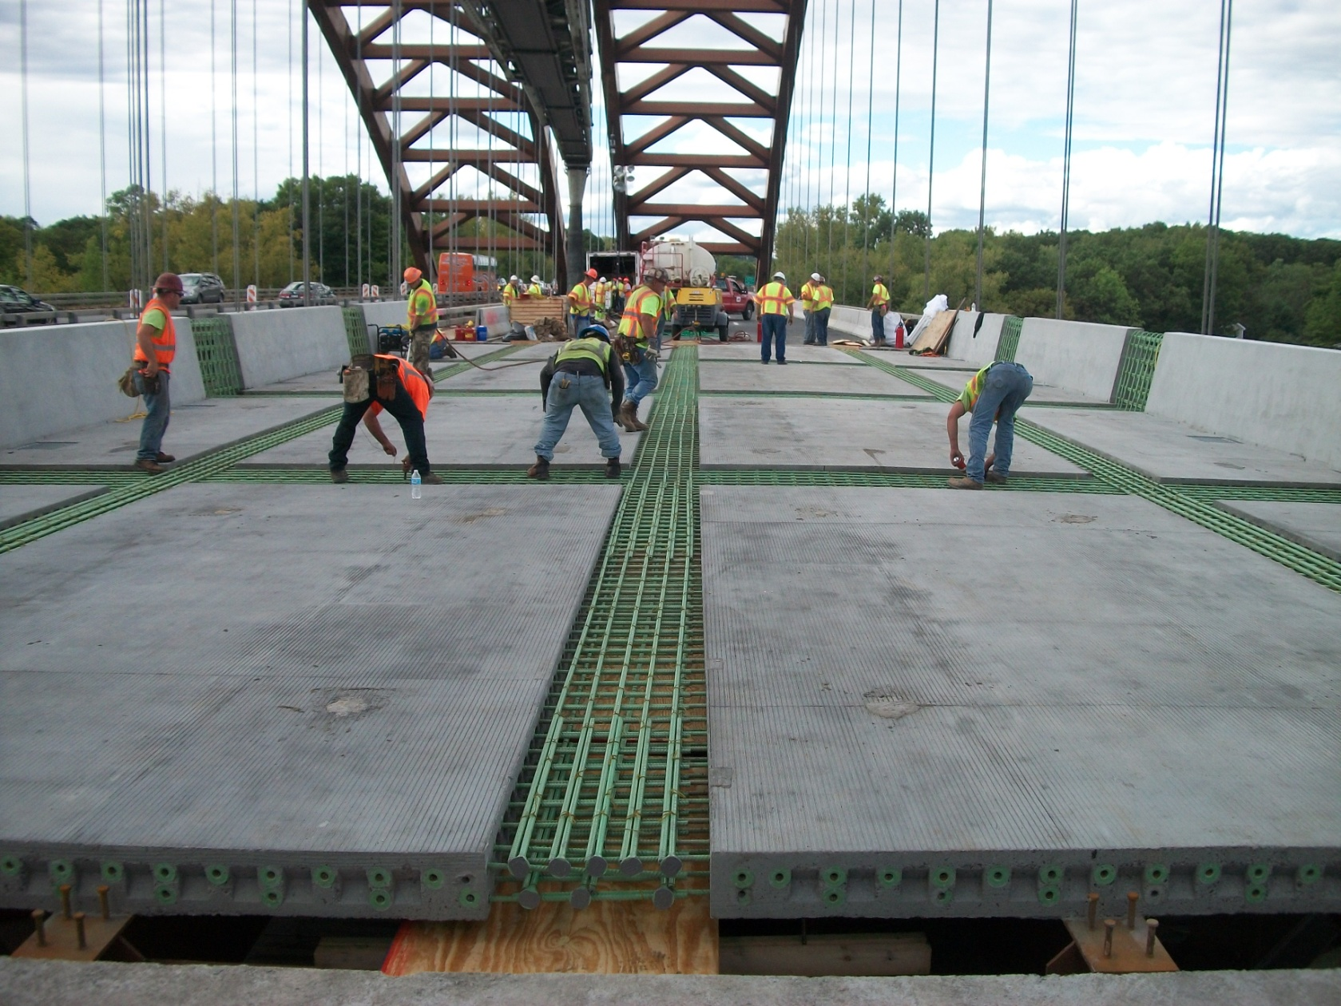

Slide 32
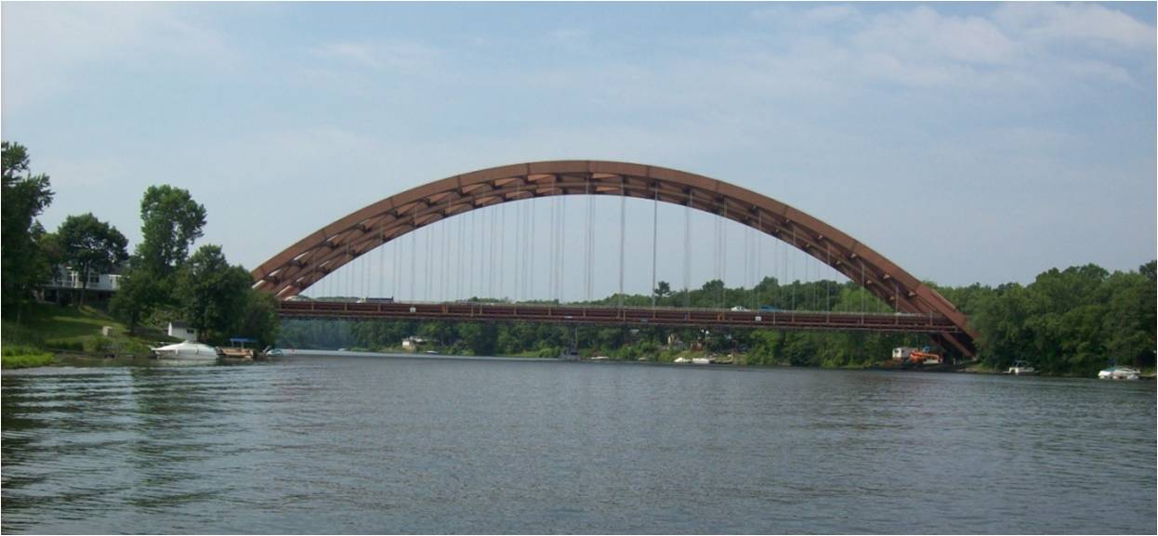

Slide 33
Any Questions?

