Slide 1
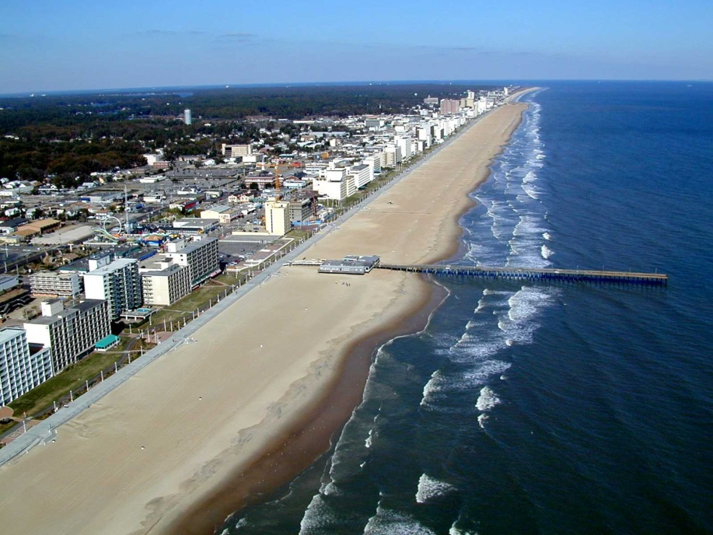
AASHTOWare Bridge Design Tool
AASHTOWare Bridge Rating/Design
User Group Training Meeting
Virginia Beach – August 2013

Slide 2
Design Tool Architecture
Standalone, modular, flexible set of single-purpose tools.
Perhaps done in such a way that they can be integrated if desired.
Does not require the AASHTOWare Bridge database, but able to connect if available.

Slide 3
Design Tool Architecture
Passes design outcome to the Bridge database if available.
UI specific to bridge design
Minimal required input, use of templates

Slide 4
Design Tool Architecture
Final Architecture will depend on:
The information collected during the Modernization workshop
TAG functional requirements
TAG review

Slide 5
Design Tool Architecture (Draft)

Slide 6
Design Tool Architecture (Draft)
Available Modules

Slide 7
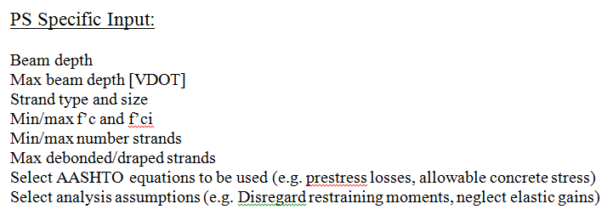
Design Tool Suggestions

Slide 8
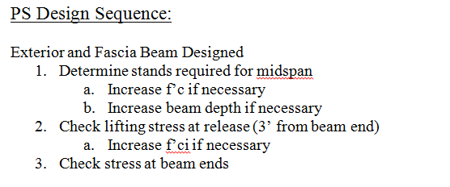
Design Tool Suggestions

Slide 9
Design Tool Suggestions

Slide 10
Thank you

